Slide 1

Design Process
Nitin Varade (UX Consultant)

Slide 2
What is Design?
Design is achieving goal with constraints
Systematic approach to find problem and provide an appropriate solution.
Goals: What is the purpose of design we are intending to produce? Who is it for? Why do they want it?
Constraint's: What materials must we use? What standards must we adopt? How much time do we have to develop it? Are there health and safety issues? Any technical constraint's?

Slide 3
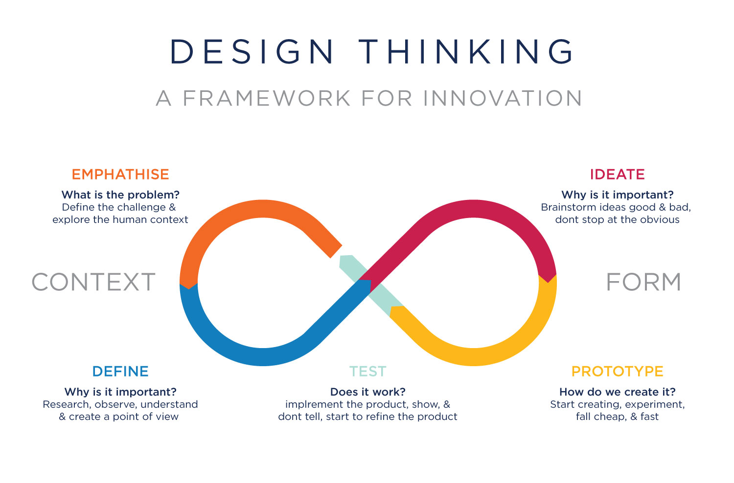
Interaction Design Process

Slide 4
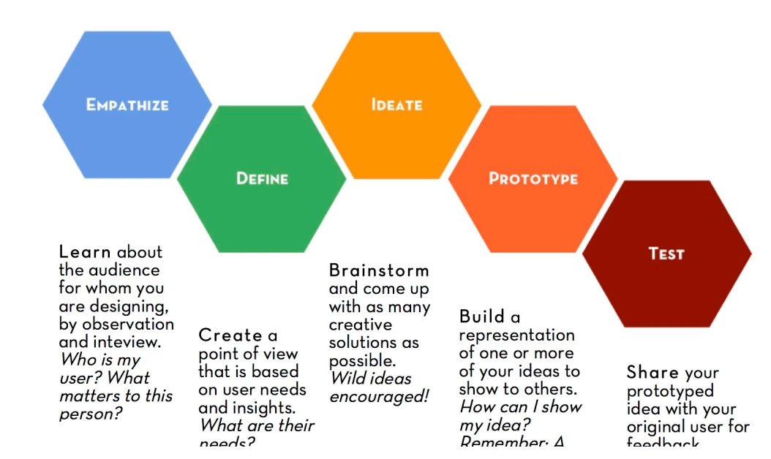
Why HCI Is Important?

Slide 5
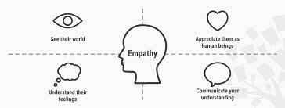
What is Empathy?
Empathy: The action of understanding, being aware of, being sensitive to, and experiencing the feelings, thoughts, and experience of another of either the past or present without having the feelings, thoughts, and experience fully communicated in an objectively explicit manner”.
When you are conducting user research, always pay attention to:
What users Say (make a note of keywords, quotes of users)
What users Think (what is their opinions, beliefs)
What users Do ( what actions and behaviors you notice)
What users Feel (what emotions, feelings you notice)

Slide 6
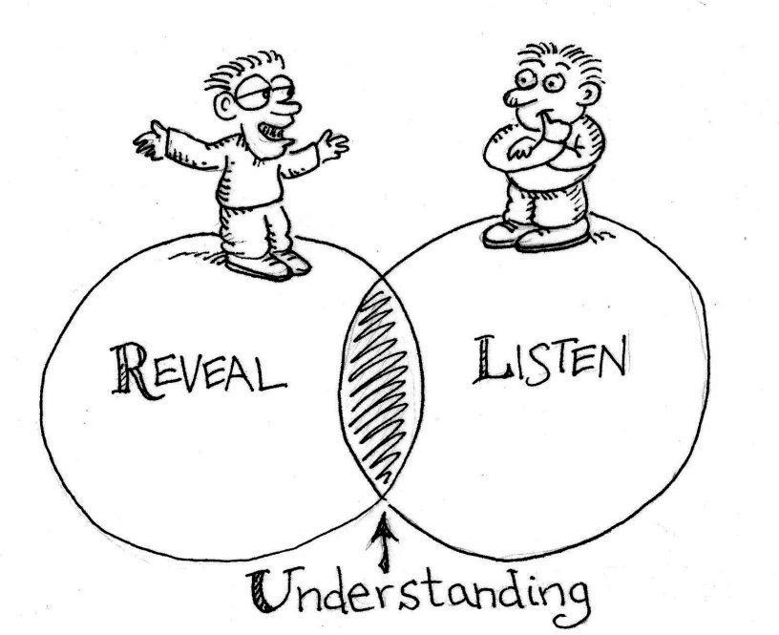
Methods or Techniques
Listening
Listening to people’s feelings, needs and being fully present at the moment when listening to others helps to establish empathy. When you open yourself up and wholeheartedly listen to others, they feel comfortable to talk their heart out. Active listening is not very natural to many of us. This can be consciously practiced so that it helps you in your research work and life in general.
Reveal:
make (previously unknown or secret information) known to others.

Slide 7

Empathy Techniques
Curiosity:
Always feed the curious cat within you. Be curious to know new things, new people, their life, feeling, problems. Curiosity is a genuine way of knowing unknown. It helps one another to open up. Don’t be an examiner, be the interested inquirer. When you are curious, you pay full attention to what you are doing, whom you are listening. Always be a curious cat, this is a great trait that helps you establish empathy with others.

Slide 8

Empathy Techniques
Have no assumption
Assumptions are always shortcuts to solve a problem. When we take shortcuts, we don’t get to see the full picture. As a result, we don’t actually solve the problem. Never make judgments about people or situations. Learn by seeing, talking, observing, discussing openly.
When you are doing user research, be open and have no prior assumptions that you know it already. When you talk to others with a clear mind, you get to know them better.

Slide 9
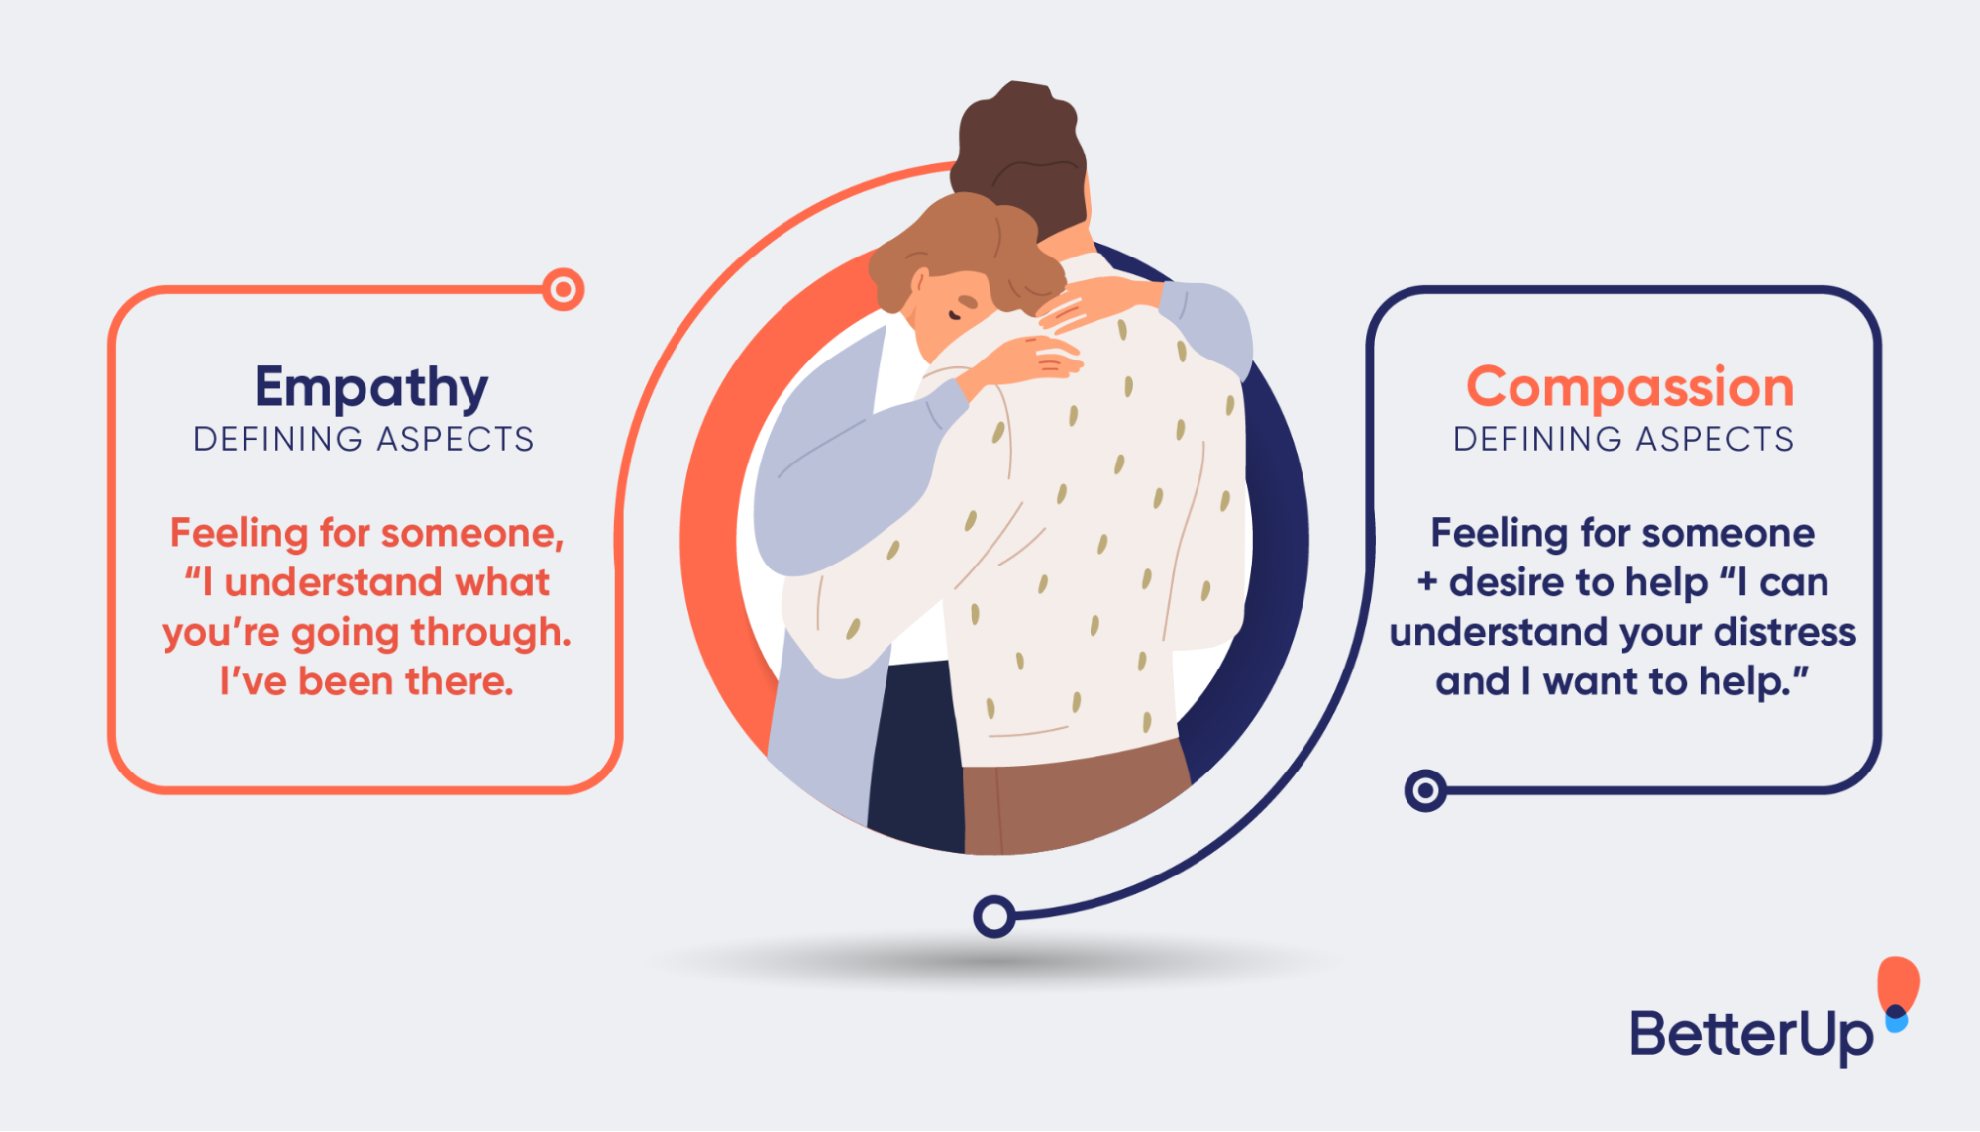
Empathy Techniques
Caring
Give importance to people. Show you care to know them, their conditions, emotions, problems, challenges etc. Make it clear that you are here to help. Empathy can be established only when you make a person comfortable, and confident to talk about them. Opening up to a stranger is always difficult, even in interviews, questionnaires, and other user research techniques, people do not easily open up. It is important to show that you genuinely care to get real user insights.

Slide 10
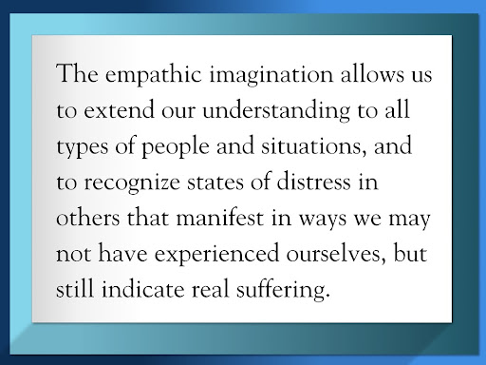
Empathy Techniques
Imagination
Use your imagination to understand users, what they might be thinking or feeling. Not everything can be explicitly communicated. Put yourself in their positions and live their life to know how it feels. Visual thinking or imagination is an important technique to empathize with others.
Base your designs on empathy. Whether you are designing for elderly, kids, sales personnel, students, mothers, cancer patients, it is important that you know them in and out, their surroundings, beliefs, fears etc. to match the user needs in real life. Make use of these empathy eliciting techniques to establish a better connect with users and transcend this understanding naturally in your designs. Let empathy guide your designs and make the digital world a better place for everyone.

Slide 11
User Research
“Empathize” is the first step in the design thinking process, and user research is one of the best ways to do that. It helps you understand your target audience, their needs and wants, and how they currently do things.
By involving potential users from the start, you can ensure there’s actually a demand for your product and position it better in the market. Placing people firmly at the center of your process and putting yourself in their shoes is the only way to design something that’s relevant and a delight to use.
It also improves the usability of your product. Really digging into user preferences might encourage design tweaks that enable you to design a product that’s not only easy, but also a delight to use, delivering a great user experience in the process. These days, user-centered design is crucial in creating a successful product in a competitive market.
Finally, user research helps you understand your product’s return on investment (ROI). Stakeholders might still be reluctant to invest in user research because it doesn’t feel that tangible. However, if you can show that the changes you’ve made — for example, based on a round of A/B testing to decide which version users prefer — have resulted in more sales or in more customers, chances are user research will become an integral part of your process.
There are many user research techniques — a lot of them surprisingly easy and cheap! — that are usually divided into qualitative and quantitative methods. Let’s take a look at some of the most popular ones.
Qualitative vs. quantitative research

Slide 12
Any Questions?
Nitin Varade
Tech Manager (UX Professional) @ Tech Mahindra
https://www.linkedin.com/in/nitinvarade/
M: 9011015213
Notes:
In Slide Show mode, select the arrows to visit links.

